Slide 1
NU Sound Audio Visualizer

Slide 2
Intro
Using an Arduino microcontroller, we will control an LED strip with sound
The brightness of the LED strip corresponds to music volume, and the color corresponds to the dominant frequency of the music
The LED strip will be placed between two two-way mirrors to create an infinity effect
Extra materials needed: Glue/tape, scissors/box-cutters/Xacto knife, a laptop, an aux chord, headphones

Slide 3
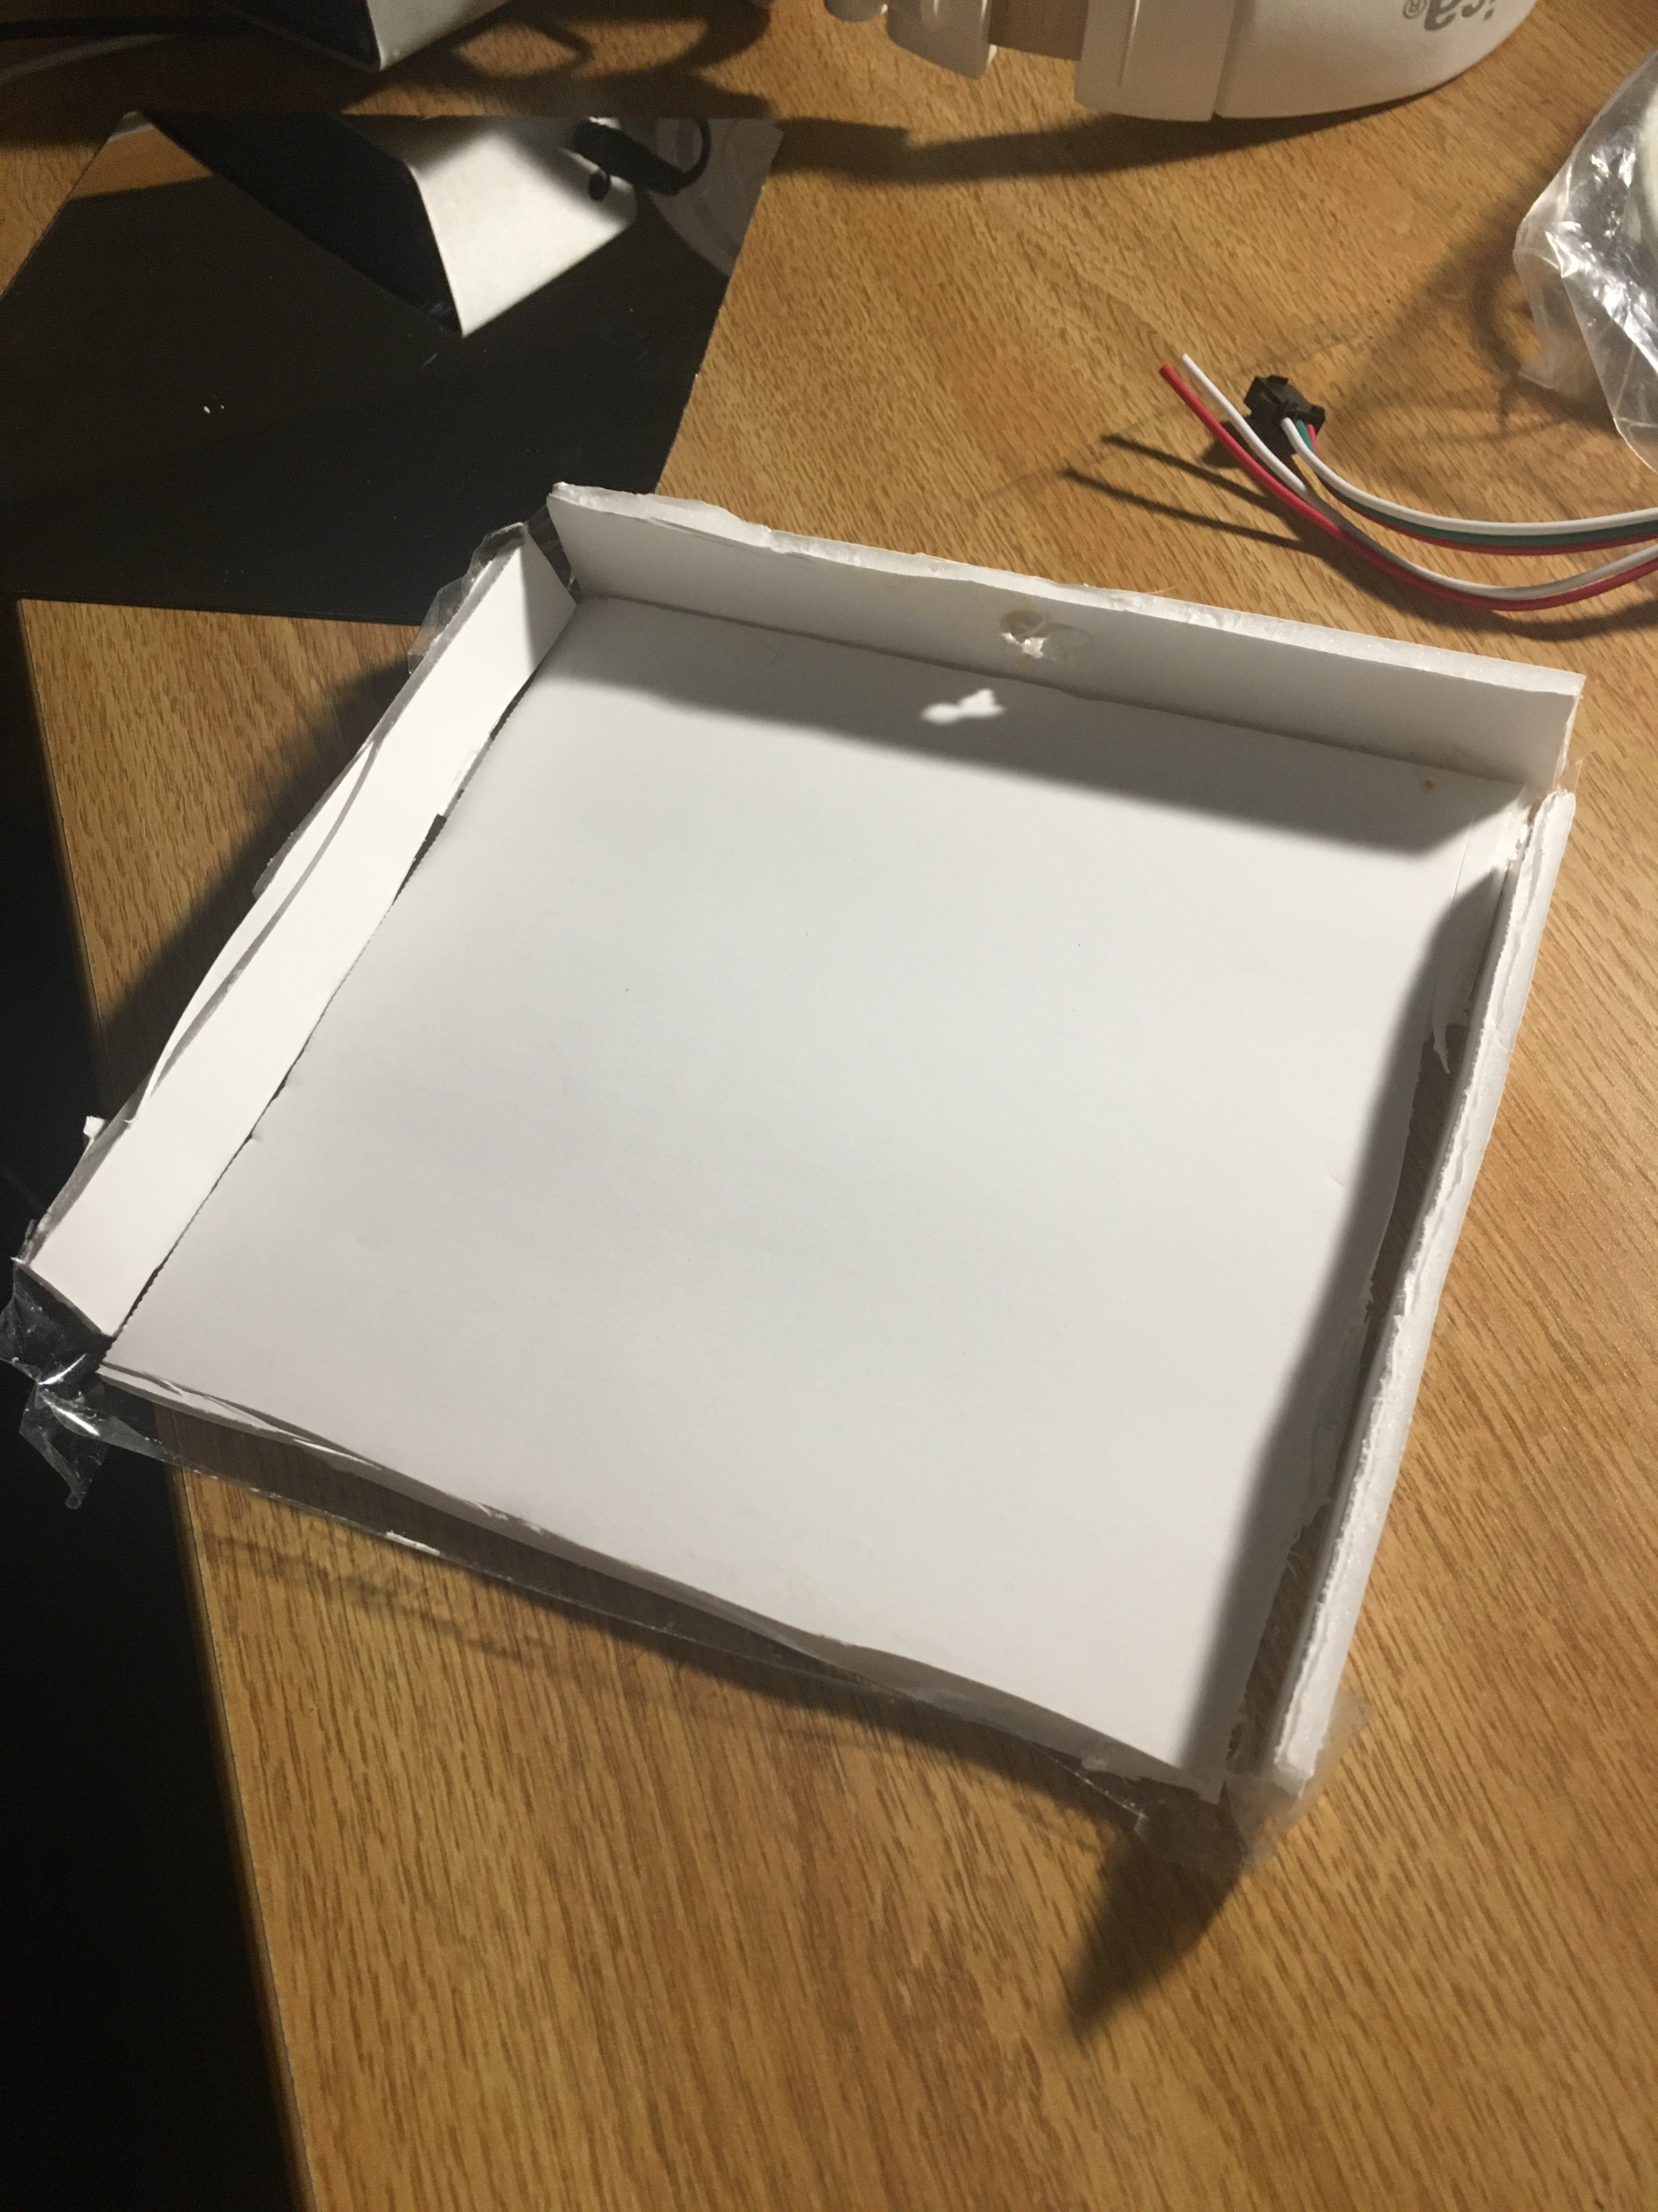
Step 1 – Prepare the enclosure
Cut a 6inX6in square out of the Styrofoam for the mirror base
Boxcutters, Xactio knife, or scissors work best
Cut out four 6-inch sides
These should be about a ½ inch tall
Cut a hole in the center of one of these sides for the LED strip wires
Glue/Tape these four sides to the edge of the base, as shown
Place one of the mirror halves on the square base

Slide 4
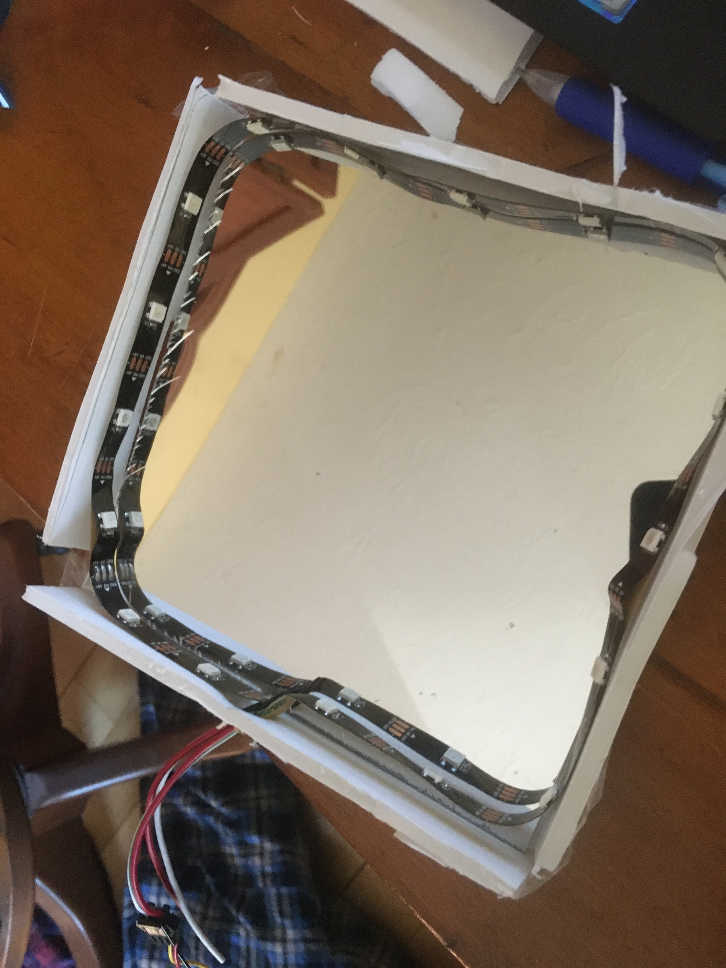
Step 2 – House the LED strip
Line the inside of the box with the LED strip
Feed the LED strip end with the black plastic female port through the hole in one of the sides
Cut off any excess LEDs so that the entire LED strip can fit inside the box
Place the second mirror on the top of the four sides (you can glue it but you may want to access the inside later)

Slide 5
Step 3 – Upload code to the Arduino
Download the Arduino software if you haven’t already: https://www.arduino.cc/en/software
Start a new project
Download the FHT library at http://wiki.openmusiclabs.com/wiki/ArduinoFHT?action=AttachFile&do=view&target=ArduinoFHT4.zip
Move the enclosed folder “FHT” to the folder “Arduino/libraries” (within the directory where your Arduino sketches are saved)
In Arduino, go to Tools → Manage Libraries
Search and install “Adafruit Neopixel”
Copy this code into your empty project: https://github.com/nickh2000/AudioVisualizer/blob/master/AudioVisualizer.ino
Connect your Arduino Nano to the computer via USB
Upload the code to the board

Slide 6
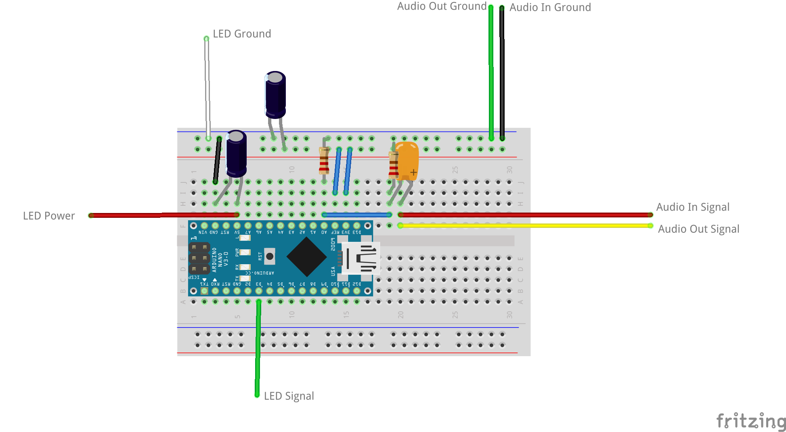
Step 4 – Assemble the Circuit
Assemble the circuit as shown in the diagram
LED strip can be connected by inserting wire segments into the LED’s black plastic ports

Slide 7
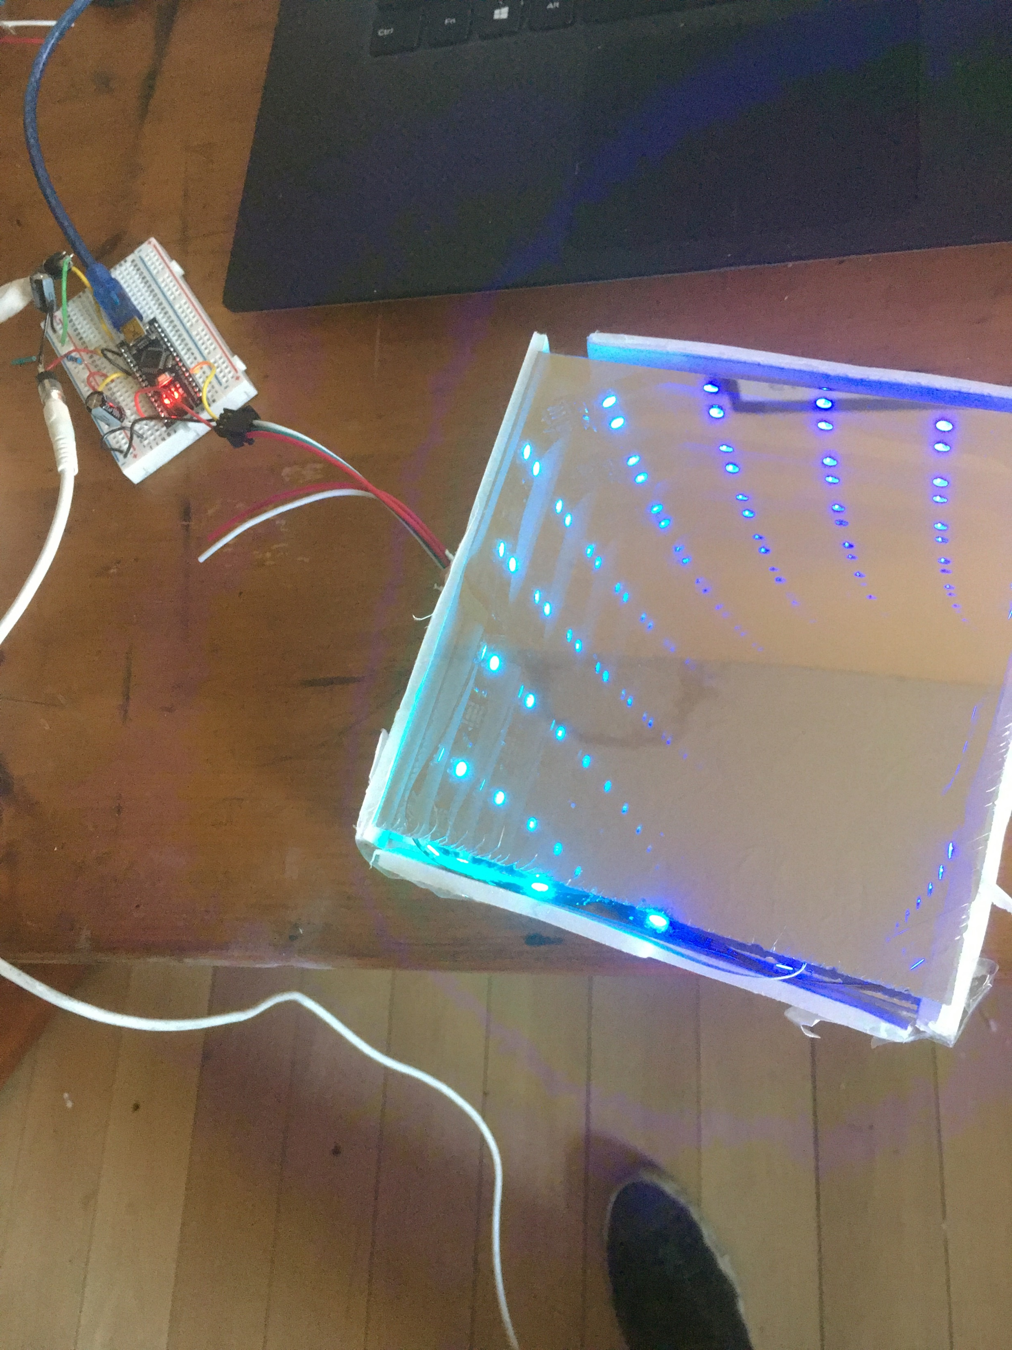
Step 5 – Test it out!
Get an aux chord and connect your phone or laptop to one of the aux jacks
Connect your headphones or speakers to the other aux port
The code is set to work best at full iPhone volume, but you can tweak the sensitivity variable in the code to have the visualizer work at whichever volume you choose

